Slide 1
Genetic Basis of cancer

Slide 2
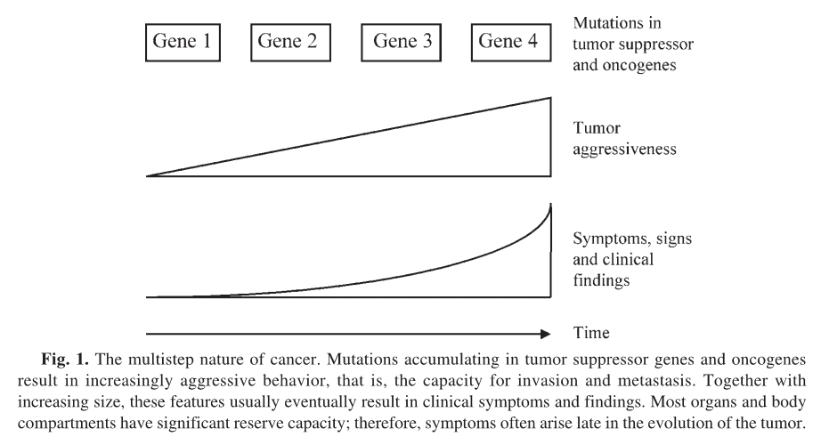
Multistep nature of cancer

Slide 3
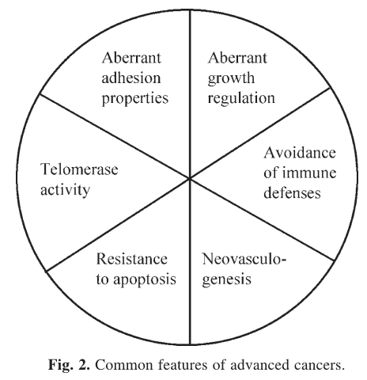
Common Feature
Dysfunction of cell cycle checkpoint
Rapidly growing tumor need and
ample supply Of oxygen and nutrients

Slide 4
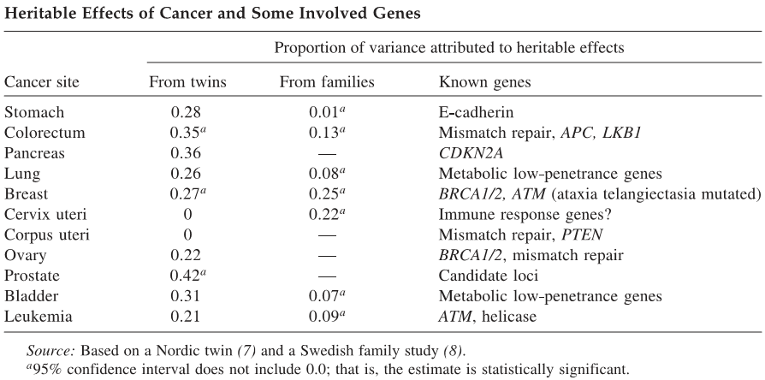
Heritable effects of cancer and some involved genes
APC: Adenomatous polyposis coli: Multiple function involved with cellular signaling and adhesion

Slide 5
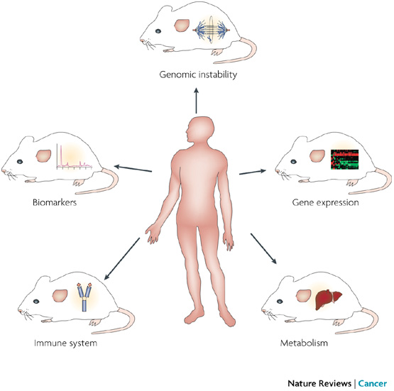
Cancer Models
Hallmarks of humanized mouse models.

Slide 6
Question ???

